Slide 1
Developing an NLP Model to Identify Depression and Suicidal Ideation in Online Posts
Our project aimed at building an NLP model to accurately detect online posts related to depression and suicide, to assist mental health organizations and governments in identifying and providing timely support to individuals expressing suicidal ideation.

Slide 2

The Team
Esther Nyokabi
Joel Lenkinyei
Tipape
Jane Kinuthia
Karura
Muthoni
Keith
Eugene
Ochieng

Slide 3

Problem Statement
Social media has become a platform for individuals to express suicidal ideation, posing a challenge to mental health professionals worldwide.
Identifying such posts online is difficult, particularly for governments and mental health organizations.

Slide 4

Data Processing
The dataset consisted of 232,074 posts, evenly split between "suicide" and "non-suicide" classes.
The data underwent text cleaning and tokenization to prepare it for modeling.
Text was further enhanced by lemmatizing words and removing stop words to improve data quality for model development

Slide 5
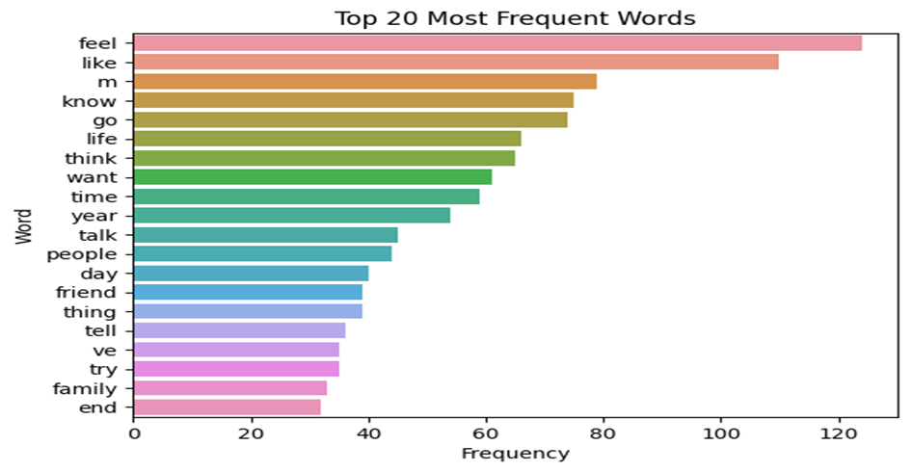
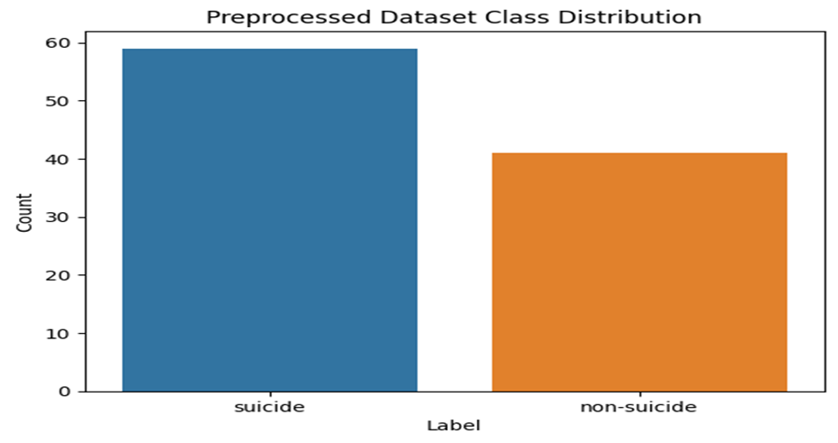
Data Exploration
Conducted visual and statistical analysis to explore the dataset.
Texts had an average length of 374.0 characters, with a standard deviation of 601.8 characters, and ranged from 20 to 3,762 characters

Slide 6

Modelling & Evaluation
The dataset was split into training (80%) and testing (20%) sets.
We developed a supervised machine learning model using Support Vector Machine (SVM), achieving an accuracy score of 75%.
The SVM model had higher recall scores for both "non-suicide" and "suicide" classes and an F1-score of 81% for the "suicide" class.
We also used Recurrent Neural Network (RNN) to improve the accuracy of the text classifier, achieving an accuracy score of 80%.

Slide 7

Findings & Conclusion
Our findings showed that both SVM and RNN models showed promise in detecting suicide ideation in online forums.
However, further research is needed to improve their performance, especially in terms of precision and recall scores for the "non-suicide" class.
Despite the limitations, the developed models can serve as a valuable tool for assisting mental health professionals in identifying individuals at risk of suicide in online forums.

Slide 8
Thank you for your time 😊

